Slide 1
COS 30049 Computing Technology Innovation Project
Week4: Data Processing via Python
Hao Zhang
hzhang1@swin.edu.au

Slide 2
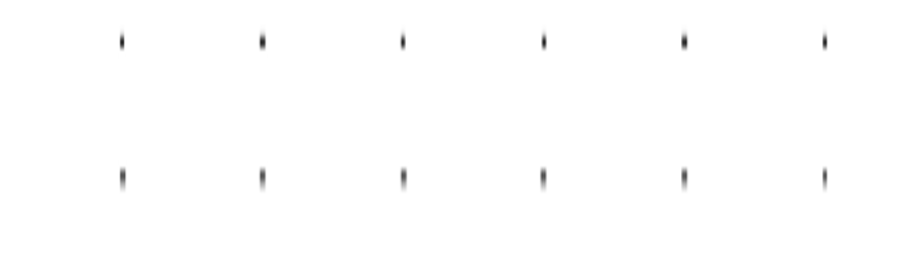

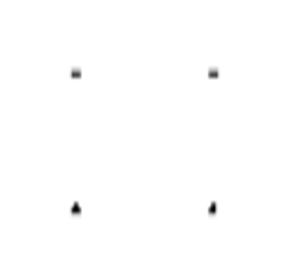

Acknowledgement of Country
We respectfully acknowledge the Wurundjeri People of the Kulin Nation, who are the Traditional Owners of the land on which Swinburne’s Australian campuses are located in Melbourne’s east and outer-east, and pay our respect to their Elders past, present and emerging.
We are honoured to recognise our connection to Wurundjeri Country, history, culture, and spirituality through these locations, and strive to ensure that we operate in a manner that respects and honours the Elders and Ancestors of these lands.
We also respectfully acknowledge Swinburne’s Aboriginal and Torres Strait Islander staff, students, alumni, partners and visitors.
We also acknowledge and respect the Traditional Owners of lands across Australia, their Elders, Ancestors, cultures, and heritage, and recognise the continuing sovereignties of all Aboriginal and Torres Strait Islander Nations.

Slide 3
Objectives: 1. Understanding data structure (CSV, text, JSON) 2. Data Preprocessing

Slide 4
Data processing language
Python (we will be using)
Multi-Purpose Language:
Fully fledged, multi purpose programming language. Being widely used in various domains, including web development, automation, and data science.
Integration:
Good for combining data wrangling activities into a larger pipeline of production or web development
Libraries and Frameworks:
Good library support for scientific and machine learning extensions, has a rich ecosystem of machine learning libraries such as TensorFlow, PyTorch, etc. These libraries are well documented and supported by a large community.
Community and Support:
Python has a large and active community, making it easier to find resources, tutorials, and support for machine learning projects.
R (we will not be using)
More of a statistics focus.
R might have a steeper learning curve for those not familiar with statistical concepts.
R is generally slower than Python when handling large datasets.

Slide 5
Open Data
Open data is publicly available for reuse. Open data can be accessed from a range of sources. High quality data can be found on government websites and institutional repositories.
Government data and statistics in Australia
Australian Government Data
Victoria Government Data
Australian Bureau of Statistics
Closing the Gap Information Repository
Institutional Repositories - consider the credibility before using
Google Dataset Search
HuggingFace
Kaggle

Slide 6
Dataset Quality Review
Evaluate the quality of the dataset, just as you would evaluate any information you find, before you use it in your assignments or projects.
Authority:
Who collected the data
Is it an educational institution, government or a reputable organisation?
If an individual has produced the dataset, are they associated with a reputable organisation or are they well-known in their field?
Coverage:
Were enough samples taken to be representative of the total population or group being researched?
Is the timeframe relevant or up-to-date?

Slide 7
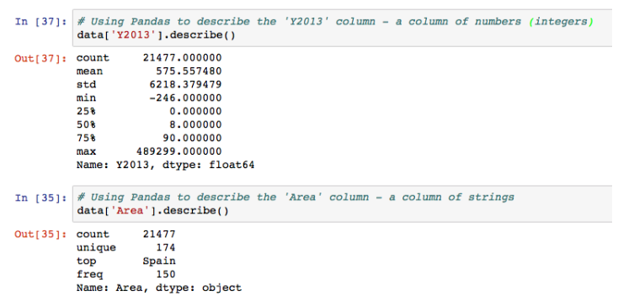
Dataset Quality Review using python
Sometimes, to gain a deeper understanding of data quality, we need to use Python to examine the dataset's quality.
We can use `pandas` package in python to do extensive data exploration
A basic descriptive statistics: `describe()` method for an overview of key statistical metrics.

Slide 8
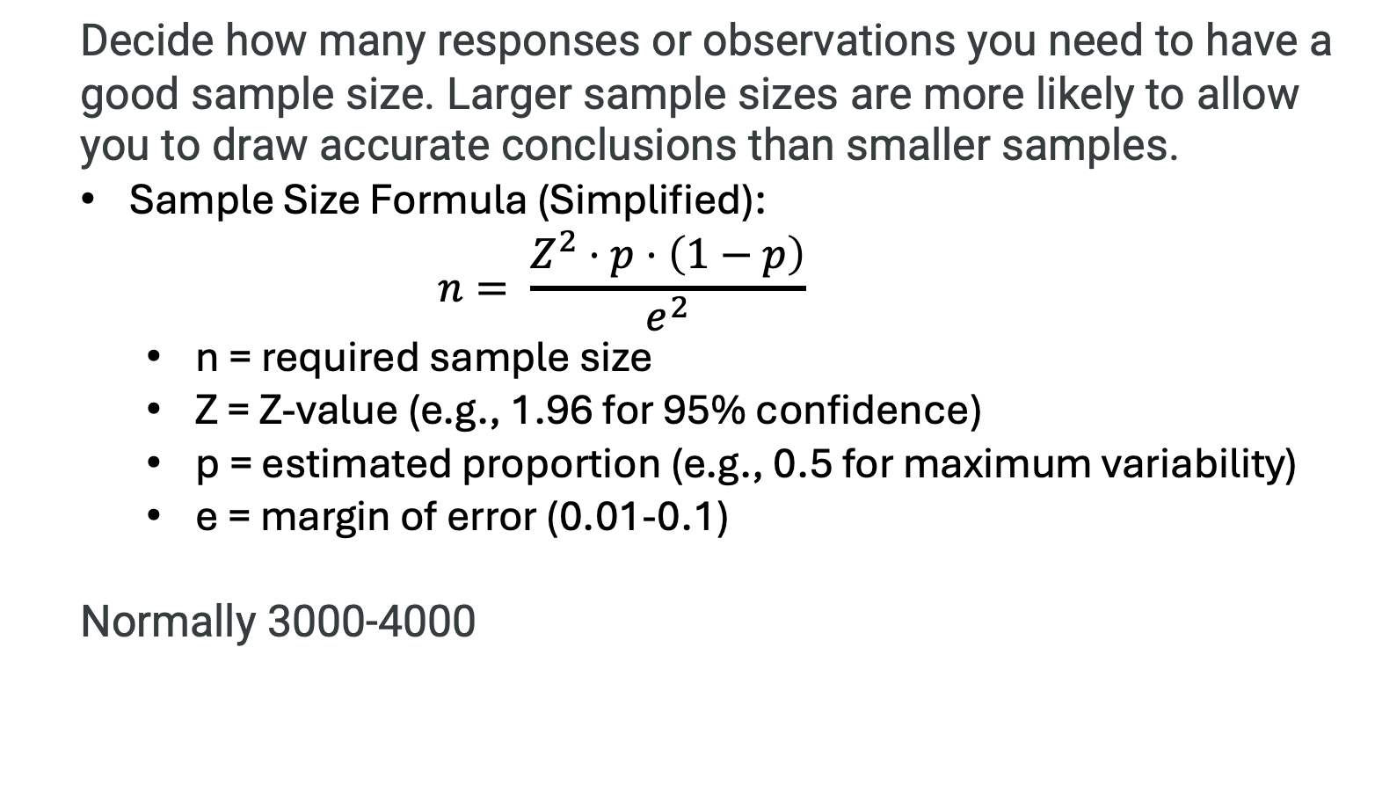
Sample size
Decide how many responses or observations you need to have a good sample size. Larger sample sizes are more likely to allow you to draw accurate conclusions than smaller samples.
Sample Size Formula (Simplified):
$$n= \frac{Z^{2}⋅p⋅\left(1−p\right)}{e^{2}}$$
n = required sample size
Z = Z-value (e.g., 1.96 for 95% confidence)
p = estimated proportion (e.g., 0.5 for maximum variability)
e = margin of error (0.01-0.1)
Normally 3000-4000

Slide 9
Understand data structure (CSV, text, JSON)
Understanding CSV (Comma-Separated Values):
Definition: A plain text format for storing tabular data where each line represents a row, and columns are separated by commas.
Widespread Use in Spreadsheets:
Huge amounts of data lives in spreadsheets
Businesses
Hospitals
Education
…
Accessible via popular tools:
Can by accessed by Microsoft (Excel), OpenOffice (Calc), Google Sheets
Other Advantages of CSV:
Human-Readable Format: Easy to view and edit using any text editor.
Compatibility: Widely supported across different software and platforms.
Simplicity: Lacks the complexity of binary formats like XLS.
Working with CSV in Python:
Popular Library: pandas
Key Function: read_csv()
Example: df = pandas.read_csv('file.csv’)
Easily load CSV data into a DataFrame for analysis.

Slide 10
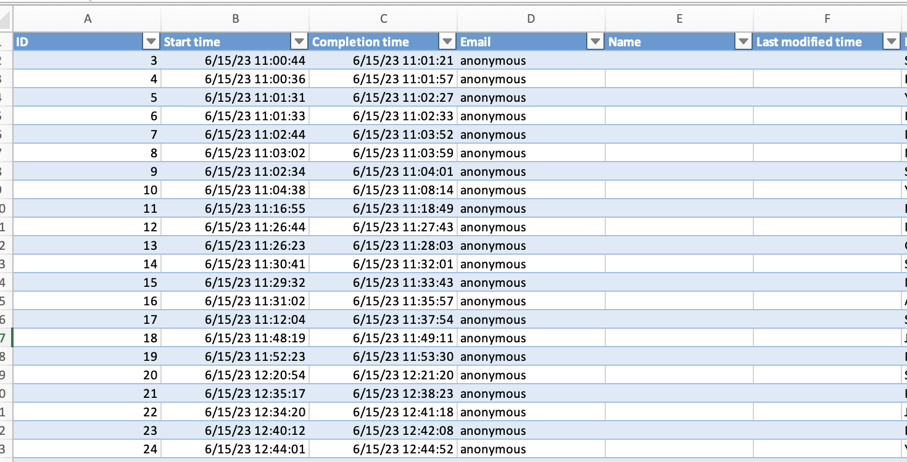
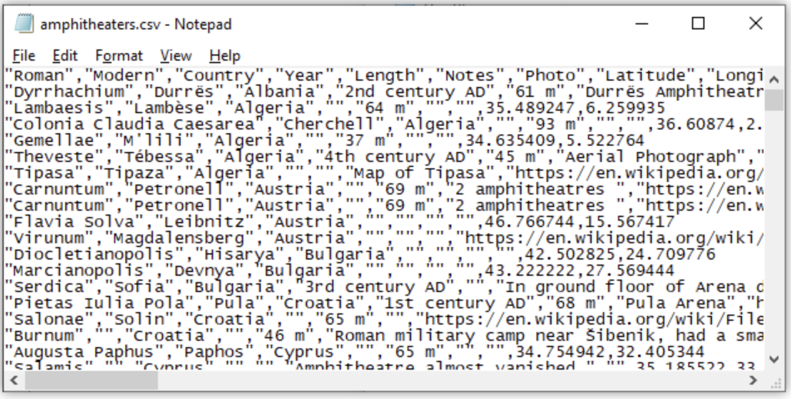
Example - Comma Separated Values (CSV)
Understand data structure (CSV, text, JSON)
Spreadsheets
Easy to use
Structured
Information in tabular format, simple but many entries
(Source)

Slide 11
Understand data structure (CSV, text, JSON)
Text – Unstructured data:
Definition: A text file is a type of digital file that contains plain text without any special formatting, such as bold, italic, or font types.
Characteristics of Text Files:
No Predefined Structure: Text files lack a fixed format, making them unstructured.
Challenges with Indexing: Harder to index due to the absence of a standard structure.
Difficulty in Organization: Managing and organizing information is more complex compared to structured data formats.
Irregularity: Text files often lack regularity and decomposable internal structures, making data processing difficult.
Common Issues:
Search and Retrieval: Without structure, searching and processing information is more challenging and may require advanced techniques like text mining or natural language processing (NLP).
Advantages of Text:
Simplicity: Easy to create, edit, and understand without specialized software.
Compatibility: Universally supported across different platforms and devices.
Small File Size: Text files typically have smaller sizes compared to binary files, making them efficient for storing simple data.
(Source)

Slide 12
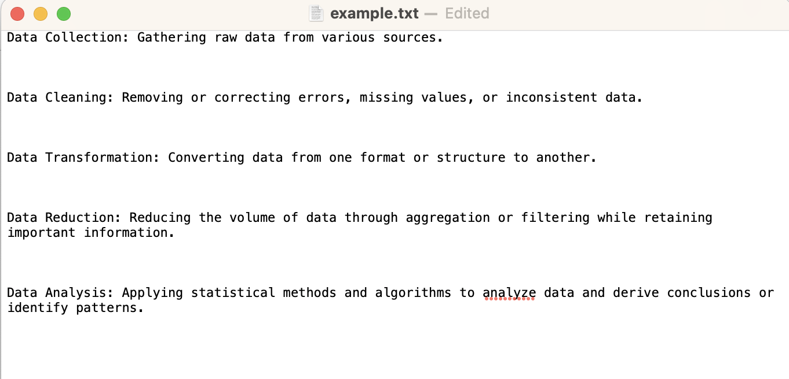
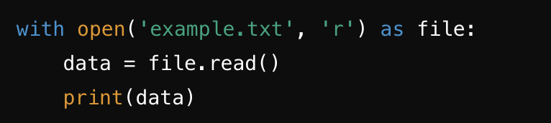
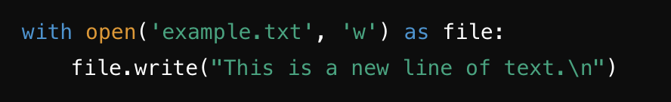
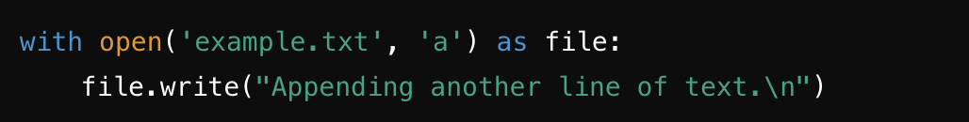
Understand data structure (CSV, text, JSON)
Text – Unstructured data
Working with Text in Python:
Reading a Text File:
Writing to a Text File:
Appending to a Text File:

Slide 13
Understand data structure (CSV, text, JSON)
Text – Unstructured data:
Scenario: we have a large collection of unformatted text data.
You need to write wrangling code in order to
– Check if it contains any IP addresses (e.g. 128.250.65.5)
– Find all the IP addresses
Requirement:
Do it succinctly
Do it unambiguously
Have maintainable code
Specifying patterns in text - regular expressions

Slide 14
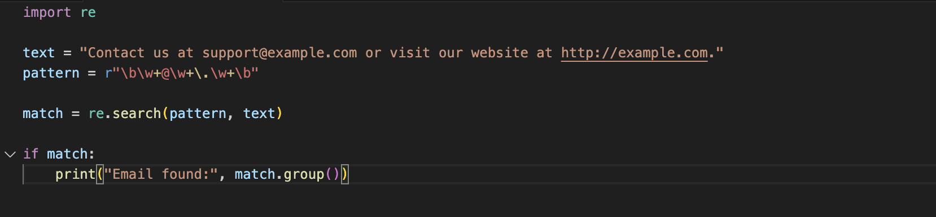
Understand data structure (CSV, text, JSON)
Text – Unstructured data:
Regular expressions: Good for computing statistics, checking integrity, filtering, substitutions...
Specifying patters in text
– ‘.’ matches any character
– ‘^’ matches start of string
– ‘$’ matches end of string
– ‘*’ zero or more repetitions
– ‘+’ one or more repetitions
– ‘|’ the “or” operator, used in conjunction with parantheses ()
- ‘[]’ a set of characters, e.g. [abcd] or [a-zA-Z]
https://docs.python.org/2/howto/regex.html
Regex101.com
e.g.
(This code searches for an email address in the text.)

Slide 15
Understand data structure (CSV, text, JSON)
Text – Unstructured data:
Advantages of using regular expression:
Regular expressions are useful in finding, replacing and extracting information from text, such as log files..
Search a document for color or neighbor with or without 'u'
Covert a tab-delimited file to a comma-delimited file
Find duplicated words in a text
Search and replace "Bob" and "Bobby" with "Robert"
Regular expression are useful in verifying whether input fits into text pattern
Verifying phone numbers
Emails
date

Slide 16
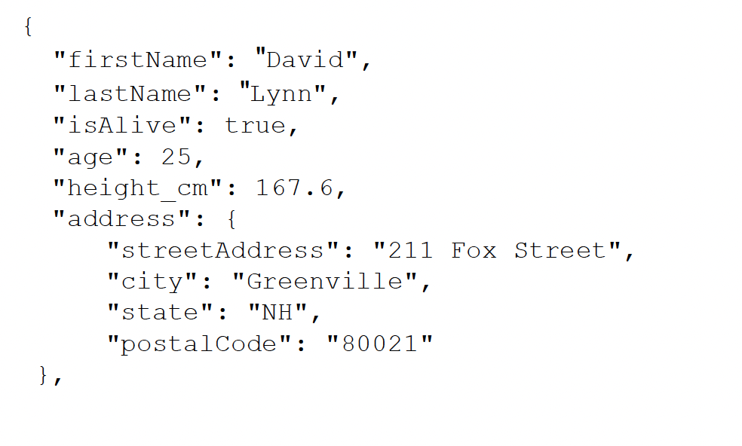
Understand data structure (CSV, text, JSON)
More structure – JavaScript Object Notation (JSON):
JSON is simpler and more compact/lightweight than XML. Easy to parse
JSON example:

Slide 17
Why is pre-processing needed?
Data of Birth
15 years ago
20/11/79
5/20/79
/
/
12/30/2003
Measuring Data Quality:
Accuracy:
Definition: Ensures that the data is correct and free from errors.
Challenge: Incorrect data can lead to faulty analysis or decisions.
Example: A date recorded as "15 years ago" instead of a specific date.
Completeness:
Definition: Ensures that all necessary data is recorded and available.
Challenge: Missing data can skew results or make certain analyses impossible.
Example: Fields with / indicating missing date of birth.
Consistency:
Definition: Ensures that data is uniform across datasets and entries.
Challenge: Inconsistent data formats can complicate processing and analysis.
Example: Different date formats like 20/11/79, 5/20/79, and 12/30/2003.
Timeliness:
Definition: Ensures that the data is up-to-date and relevant.
Challenge: Outdated data may not reflect current realities and lead to incorrect conclusions.
Example: Data not updated in a timely manner.
Believability:
Definition: Ensures that data is credible and trustworthy.
Challenge: Data that is hard to interpret or understand may reduce confidence in its accuracy.
Example: Mixed formats or vague entries that make it hard to assess the data.

Slide 18
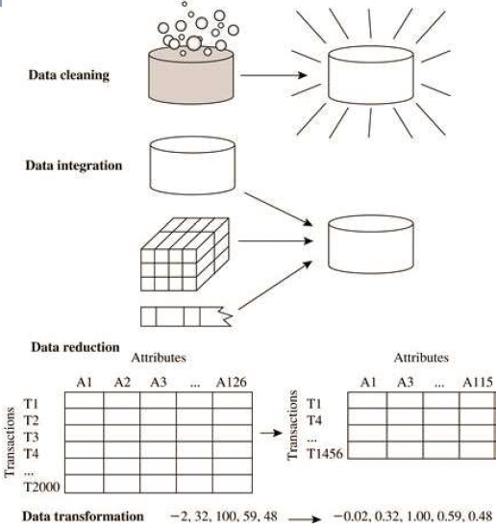
Major data preprocessing activities
Data Cleaning: Removing or correcting errors, missing values, or inconsistent data.​
​Data integration: Integrating multiple data
Data Reduction: Reducing the volume of data through aggregation or filtering while retaining important information.​
Data Transformation: Converting data from one format or structure to another.

Slide 19
Data cleaning - The Process
Overview of Data Cleaning Tools:
Popular Tools:
Google Refine (now OpenRefine):
Ideal for exploring, cleaning, and transforming data.
Kettle (Pentaho Data Integration):
Supports ETL (Extract, Transform, Load) processes with a graphical interface.
Talend:
A comprehensive platform for data integration, big data, and ETL tasks.
Key Data Cleaning Tasks:
Data Scrubbing:
Definition: Removing or correcting inaccurate or corrupt data.
Example: Removing erroneous entries like "N/A" or "unknown."
Data Discrepancy Detection:
Definition: Identifying and resolving inconsistencies in data entries.
Example: Ensuring uniform date formats (e.g., MM/DD/YYYY).
Data Auditing:
Definition: Systematic examination of data to ensure quality and consistency.
Example: Verifying that all required fields are populated.
ETL (Extract, Transform, Load):
Definition: The process of extracting data from sources, transforming it into a suitable format, and loading it into a target system.
Example: Migrating data from a CSV file to a database while cleaning and formatting it.

Slide 20
Data cleaning - The Process
Our emphasis will be to understand some of the methods employed by some of these tools to deal with:
Noisy data
Inconsistent data
Incomplete (missing data)

Slide 21
Noisy data
Examples of Noisy Data:
Truncated Fields:
Issue: Data fields are cut off due to exceeding a character limit (e.g., 80 characters).
Impact: Loss of critical information and incomplete data entries.
Incorrectly Split Text:
Issue: Text that should be in one cell is improperly split across multiple cells.
Impact: Misalignment of data, leading to incorrect analysis.
Invalid Values:
Example: A salary recorded as "-5," which is not a valid value.
Impact: Distorts statistical analysis and data interpretation.
Common Causes of Noisy Data:
Imprecise Instruments:
Description: Measurement tools that lack precision or calibration.
Example: Sensors that record data with slight deviations, leading to inaccurate readings.
Data Entry Issues:
Description: Human errors during manual data entry.
Example: Typing mistakes, such as entering "52.3" instead of "5.23."
Data Transmission Issues:
Description: Errors occurring during the transfer of data between systems.
Example: Corruption of data files during network transmission, leading to incomplete or garbled records.

Slide 22
Inconsistent data
Examples of Inconsistent Data:
Different Naming Representations:
Issue: Variations in how names or entities are represented.
Example: "Swinburne University of Technology" vs. "Swinburne" or "1" vs. "ONE".
Impact: Can cause confusion, duplicate records, or issues in data aggregation.
Different Date Formats:
Issue: Inconsistent formats for dates across the dataset.
Example: "01.11.1994" (DD.MM.YYYY) vs. "01/11/1994" (MM/DD/YYYY).
Impact: Misinterpretation of dates leading to errors in analysis.
Duplicate Unique IDs:
Issue: Two records with the same unique identifier.
Example: Two people with the same ID number.
Impact: Complicates data integrity and can lead to inaccuracies in record retrieval.
Outliers:
Example: Age of students recorded as {22, 17, 23, 33, 24, 34, 999}.
Issue: 999 is clearly an outlier and not a realistic age.
Impact: Skews statistical analysis and may indicate an error in data entry or transmission.

Slide 23
Inconsistent data
Handling Inconsistent Data:
For Outliers:
Condition 1: Keep It
When: The outlier is reasonable and within acceptable limits.
Condition 2: Impute It
When: Domain knowledge is insufficient to accurately determine the correct value.
Action: Use statistical methods or average values for imputation.
Condition 3: Correct It
When: Domain knowledge allows for accurate inference.
Example: Replace 999 with a realistic age based on the context.

Slide 24
Missing or incomplete data
Lacking Feature Values:
Common Scenarios:
Empty Fields:
Example: Name = ” " (empty string)
Null Values:
Example: Age = null (no data recorded)
Impact: Missing values can lead to incomplete analysis, bias, and errors in data interpretation.
Types of Missing Data (Rubin, 1976):
Missing Completely at Random (MCAR):
Definition: Data is missing independently of both observed and unobserved data. The missingness has no pattern or relationship with any other data.
Example: Flipping a coin to decide whether or not to answer an exam question.
Impact: MCAR data can be handled more easily as it doesn’t introduce bias.
Missing Not Completely at Random (MNAR):
Definition: The likelihood of data being missing is related to the unobserved data. There is a pattern or reason behind the missingness.
Example: A survey on health, where non-responders might be less healthy, leading to non-random missing data.
Impact: MNAR data can introduce bias and requires more sophisticated handling techniques.

Slide 25
Dealing with missing data
Delete all instances with a missing value
Sometimes called case deletion
Effects
Easy to analyse the new
May produce bias on analysis if new sample size small or structure exists in the missing data
Manually correct
A human eyeballs the missing value and fills it in using their expert knowledge
Imputation: imputing all missing values (e.g., fill in with zeros, means and median...)

Slide 26
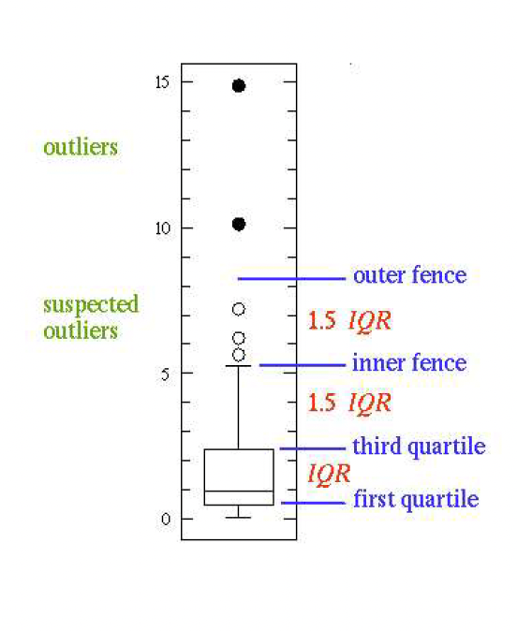
Outlier Analysis
Outlier: A data object that deviates significantly from the normal objects as if it were generated by a different mechanism
From a statistics perspective:
Suspected outliers :
>1.5 IQR above third quartile
>1.5 IQR below 1st quartile
How to deal with outlier ?
Similar to missing data
The Interquartile Range (IQR) is a measure of statistical dispersion, which represents the range within which the middle 50% of the data points lie. It is calculated by subtracting the first quartile (Q1) from the third quartile (Q3) in a dataset.
Key Points about IQR:
Quartiles:
First Quartile (Q1): The median of the lower half of the dataset, which represents the 25th percentile.
Third Quartile (Q3): The median of the upper half of the dataset, which represents the 75th percentile.
Calculation:
IQR=Q3−Q1

Slide 27
Thank you

